Slide 1
Hostel Management System
MADEBY TEAM:-SGH000675
PRESENTED BY:-
Kashish Shah
Rishang Bhavsar
Parth Shah
Kasimali Dhuka
Astha Shah
Mahi Patel

Slide 2
INTRODUCTION
The HOSTEL MANAGEMENT SYSTEM is fully web based portal to provide accommodation to the college students who came far away for studies. So basically they need to travel for hostel near to their college or university and sometimes students are unaware of some hostels too. Thus, our portal will provide them all information regarding the hostel with its address, phone number, fees and etc. So the students have to send a request to the hostel for the reservation.
The hostel manager can also access the portal and accept the student’s request to allot a room for them. And after allotment the student gets a mail from hostel that his/her request has been accepted and a code which he/she has to show in the hostel before entering in for the confirmation and room allotment. This is an efficient way for those students who come from different states and cities.

Slide 3
MODULES
Registration
Login
Payment
Fees Structure
Hostel for boys
Hostel for Girls

Slide 4
MODULES
Registration Module:-
Add member details
Generate the unique id
Update information
Search students
Login Module:-
Login via Email
Password
Fees Module:-
Student name
Fees amount
Generate fees receipt id

Slide 5
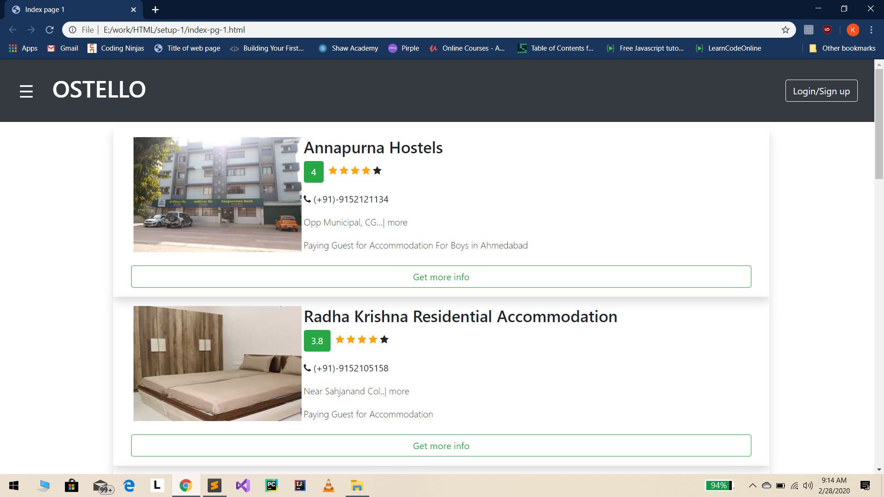
HOME PAGE

Slide 6
DATA DICTINORY 1. REGISTRATION
Field name | Data type | Constrains | Description
First name | Varchar2(50) | Not null | It stores first name of person
Last name | Varchar2(30) | Not null | It stores last name of person
Gender | Varchar2(6) | Not null | It stores gender of person
Contact no | Numeric(10) | Not null | It stores contact info. of person
Address | Varchar2(200) | Not null | It stores address of person
City | Varchar2(20) | Foreign key | Reference from city table
Pin code | Numeric(8) | Not null | It stores pin code
State | Varchar2(20) | Foreign key | Reference from state table
E- mail | Varchar2(20) | Not null | It stores email address of person

Slide 7
2. PAYMENT
Field name | Data type | Constrains | Description
Payment id | Integer(50) | Primary key | It stores of the payment id
Payment method | Varchar2(200) | Not null | It stores payment method of user
User name | Varchar2(20) | Foreign key | It store user name
Bank name | Varchar2(50) | Not null | It store the bank name
Branch | Varchar2(100) | Not null | It store the branch name
IFSC code | Integer(20) | Not null | It store the IFSC code
Card no | Integer(15) | Not null | It stores credit no of user
Amount | Decimal(5,3) | Not null | It stores amount
Message | Vachar2(100) | Not null | It stores message

Slide 8
3. LOGIN
Field name12 | Data type | Constrains | Description
Email id | Varchar2(100) | Primary key | It stores unique id
Password | nvarchar2(20) | Not null | It stores password

Slide 9
4. ROOM STRUCTURE
Field name | Data type | Constrains | Description
Room id | Integer(10) | Primary key | It stores room id
Login id | Varchar2(20) | Foreign key | It stores login id
No of student | Numeric(4) | Not null | It stores student name

Slide 10
5. HOSTELS
Field name | Data type | Constrains | Description
Hostel id | Integer(10) | Primary key | It stores Hostel id
Login id | Integer(10) | Foreign key | It stores login id
Fees | Integer(20) | Not null | It stores Fees amount
Student name | Varchar2(30) | Not null | It stores student name

Slide 11
6. FEES STRUCTURE
Field name | Data type | Constrains | Description
Fess id | Varchar2(30) | Primary key | It stores fees id
Method | Varchar2(30) | Not null | It stores fees payment method
Amount | Integer(10) | Not null | It stores amount

Slide 12
7. CATEGORY-INFORMATION
Field name | Data type | Constrains | Description
Category id | Integer(10) | Primary key | It stores Category id
Category name | Varchar2(20) | Not null | It stores Category name

Slide 13
8. CITY
Field name | Data type | Constrains | Description
City id | Integer(10) | Primary key | It stores city id
City name | Varchar2(20) | Not null | It stores city name

Slide 14
9. Feedback
Field name | Data type | Constrains | Description
Feedback id | Integer(10) | Primary key | It stores city id
User id | Varchar2(10) | Foreign key | It stores user id
Comment | Varchar2(100) | Not null | It stores comment of client

Slide 15
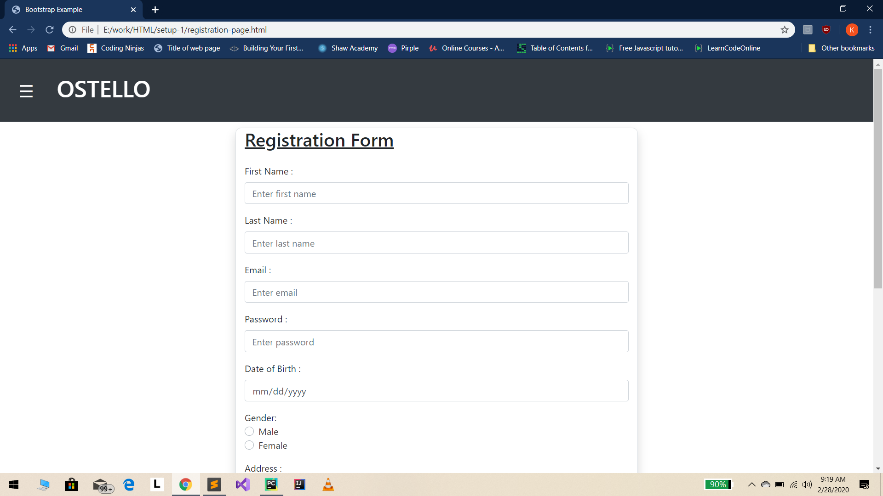
REGISTRATION PAGE

Slide 16
CONCLUSION
It is easy for the students an the or parents to get all the information of the hostels without any physical work or manually checking.
They will get all information of hostel on one click.
It will also provides online fees transfer which the hostel manager keeps there cord of the payment with the students data.

Slide 17
REFRENCES
https://www.google.com
https://www.slideshare.net/hostel-management-system-report

Slide 18
Thank You..!

